Slide 1

Student Health Services
The University of Akron
Marisa Porter, BSN, RN
healthservices@uakron.edu

Slide 2


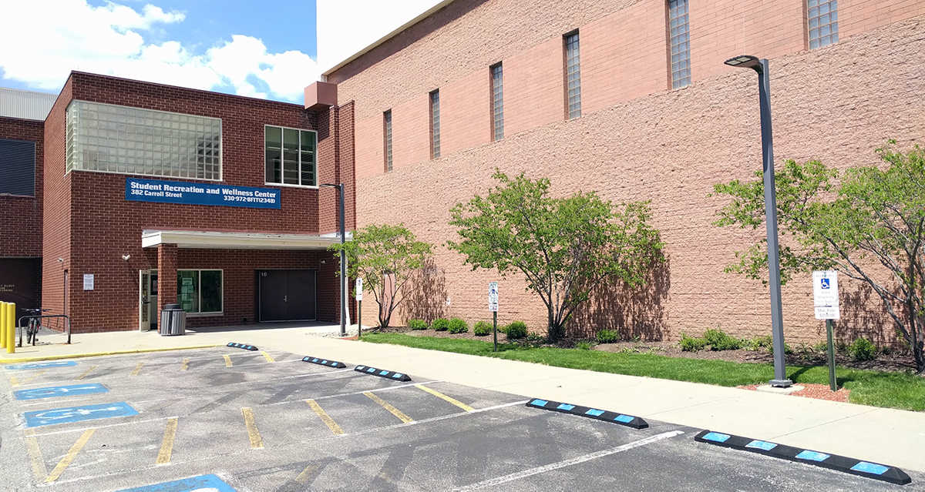
Our location
Inside the Student Recreation and Wellness Center (SRWC) Suite #260
Front entrance: go up the ramp under brick archways and turn right
Parking: Lot 10 with valid parking permit and enter through door 17

Slide 3

Hours
Academic Year
Monday through Friday
8 am to 5 pm
Summer
Monday through Friday
8 am to 4:30 pm
Closed daily from 12 to 1 for lunch
Closed on weekends and university holidays
Closed during Winter Break
Open during Spring Break

Slide 4




Our staff
Board-Certified Nurse Practitioners
Registered Nurses
Medical Secretary

Slide 5

Our Services
Acute illness
  Cough/cold, earache, sore throat, urinary issues, minor cuts and burns
Minor injuries
Physical exams for university-related programs and employment​
Diagnostic blood work​
Vaccines
  Tdap, Hepatitis B, Influenza, Covid-19 when available
Sexually-transmitted infections
Women's health – routine reproductive screening and contraception
Mental health

Slide 6
Appointments
Call 330-972-7808 or email healthservices@uakron.edu
Please give the following information:
FULL and LEGAL first and last name(s), date of birth, UA student ID number, phone number, and reason for your appointment

Slide 7

Appointments
Same-day or next-day appointments
are often available
Please be on time
Call us if you are running late
Please wear a mask

Slide 8


When to go the hospital
Fever greater than 103°F
Intolerable pain​
Uncontrollable bleeding
Severe dehydration
Severe shortness of breath or difficulty breathing​
Chest pain or pressure​
Concern for poisoning​
Head injuries
Loss of consciousness
Known or suspected seizure
Severe or worsening wound
Severe or worsening insect or animal bite
Unexplained confusion or disorientation
Broken bones
Serious skin burns
Known or suspected sexual assault

Slide 9

Medical Emergencies
If you need an ambulance:​ Call 911 from a cell phone​ or from a blue-light campus phone
Campus Police: 330-972-2911
​
Please note: Any costs associated with an ambulance ride or hospital fees are the responsibility of the student

Slide 10


Health insurance
Having health insurance does NOT mean that all medical care is free or will be 100% covered
Questions about coverage?
  Visit website: https://www.lewermark.com/
  Email: lewermarksupport@lewer.com or Maddy Rivas at rivas@uakron.edu
  Call: 800-821-7710 (for language assistance: 800-821-7715)
Patient goes to the doctor/healthcare facility
Doctor/healthcare facility sends costs of the visit to insurance company and/or lab (if patient has testing)
Insurance company and/or lab pays their portion
Remaining balance is billed to the patient to pay

Slide 11
Tuberculosis (TB)
Testing
Results
Screening
Serious and contagious bacterial infection of lungs, but can also affect kidneys, spine, and brain
TB screening is REQUIRED of ALL incoming international students
TB testing will be REQUIRED ONLY for students who meet guidelines from the WHO (World Health Organization)
Learn more: https://www.cdc.gov/tb/default.htm
Complete online TB survey
(will get an email)
Negative = done
Positive = chest
x-ray and possible treatment
If needed, have blood test
(will get an email)

Slide 12

Covid-19
Med+Proctor
  Upload your vaccine documents: https://www.medproctor.com/
  Document must be in English and not a QR code
Vaccines
  May be offered on campus (announced via email)
  Find vaccines here: https://www.vaccines.gov/
Testing
  Asymptomatic and/or known exposure: email covid@uakron.edu for information
  Symptomatic: schedule appointment at Health Services
  Surveillance testing: students are randomly selected and will be contacted by email

Slide 13
Important items
Documents
First Aid Items
for Apartments/Dorm Rooms
Travel documents
(passport, identification card)
Vaccine records in English
Copy of insurance card – front and back
List of current medications, vitamins, and supplements
List of all past and present health conditions
List of allergies
Emergency contact information
  Band-aids/bandages
  Hydrogen peroxide/saline, antibiotic ointment, antipruritic cream
  Thermometer
  Cold/hot pack
  Pain reliever/fever reducers
  (acetaminophen, paracetamol, ibuprofen)
  Cough/cold medications, allergy medications

Slide 14
On-campus health & wellness resources
Counseling and Testing Center
Stress Management, Therapy Services, and Academic Success
  Simmons Hall, Room 306
  330-972-7082
  https://www.uakron.edu/counseling/
Nutrition Center
Dietary Concerns, Healthy Eating Habits
  Schrank Hall South, Room 210
  330-972-2836
  nutritioncenter@uakron.edu
  Office of Accessibility
  Accomodations and Support for Students with Disabilities
  330-972-7928
  access@uakron.edu
  ZipAssist
Resources, Support, and Assistance for Students
  330-972-7272
  uazipassist@uakron.edu

Slide 15


VIRTUAL WELLNESS RESOURCES
Online counseling, stress management tools, mental health support, peer support​
​
Designed to help students adjust to life in the U.S.​
Offered through Lewermark Student
Insurance at no extra charge

Slide 16
Off-campus Health & wellness resources
Summa Health ER (open 24/7)
151 N Forge St, Akron
330-375-3361
Cleveland Clinic Akron General ER (open 24/7)
1 Akron General Ave, Akron
330-344-6000
Summa Health Urgent Care
Care of minor illnesses and injuries
Many locations:
https://www.summahealth.org/locations/urgentcarefacilities
AxessPointe Community Health Center
Many locations: https://axesspointe.org/
Offers vaccines, vision and dental care, women’s health, primary care, behavioral health, pharmacy services, and assistance with food, hygeine products, transportation, housing / utility needs
Summit County Health Department
1867 W Market St, Akron
330-923-4891
https://www.scph.org/
Offers vaccines, dental care, women's health, STI & HIV testing, smoking cessation resources, community resources
Akron resources: https://www.scph.org/sites/default/files/editor/021%20Street%20Card_0.pdf

Slide 17



THANK YoU!
  Questions?
  Contact Health Services
  healthservices@uakron.edu
  330-972-7808

